Slide 1


Chapter Two
Labour Supply: Individual Attachment to the Labour Market
Prepared by Dr. Mir Ahasan Kabir
York University

Slide 2
Learning Objectives
Define the key elements of labour force measurement - employment, unemployment, labour force participation, and hours worked - and explain how they are measured and reported by Statistics Canada.
Illustrate graphically how the income-leisure model reflects the trade-offs that consumers face in deciding whether and how much to work.
Distinguish theoretically between the work choices made by individuals and the economic opportunities that they choose from.
Explain using diagrams how an increase in the wage rate leads to offsetting income and substitution effects, and how this yields an ambiguous effect of wage changes on labour supply.
Interpret the economic and other factors affecting a married woman’s decision to work and show how this decision can be captured within the income-leisure (labour supply) model.
© 2021 MCGRAW-HILL EDUCATION LTD.
2-<number>

Slide 3
Main Questions
How do we measure labour market attachment? How did labour market attachment evolve over the twentieth century?
What is the labour force participation decision, and how does it fit into the general theory of labour supply?
How can we incorporate the possibly different factors that determine men’s and women’s labour supply decisions?
Is there any theoretical reason to believe that labour supply increases with the market wage?
What is the evidence regarding the responsiveness of individual labour supply to changes in the wage?
Why are workers paid an overtime premium, rather than just a higher wage, in order to induce them to work overtime?
© 2021 MCGRAW-HILL EDUCATION LTD.
2-<number>

Slide 4
The Theory of Labour Supply
Quantifying Labour Market Attachment
Labour Force (LF)
  Individuals in the eligible population (15 years and older) who participate in labour market activities, either employed or unemployed
Labour Force Participation Rate (LFPR)
  The fraction of the eligible population that participates in the labour force
  LFPR = LF/POP
© 2021 MCGRAW-HILL EDUCATION LTD.
2-<number>

Slide 5
The Theory of Labour Supply
Unemployment
To be considered unemployed, a person must be in one of the following three categories:
  Without work but has made specific efforts to find a job within the previous four weeks
  Waiting to be called back to a job from which he or she has been laid off
  Waiting to start a new job within four weeks
© 2021 MCGRAW-HILL EDUCATION LTD.
2-<number>

Slide 6
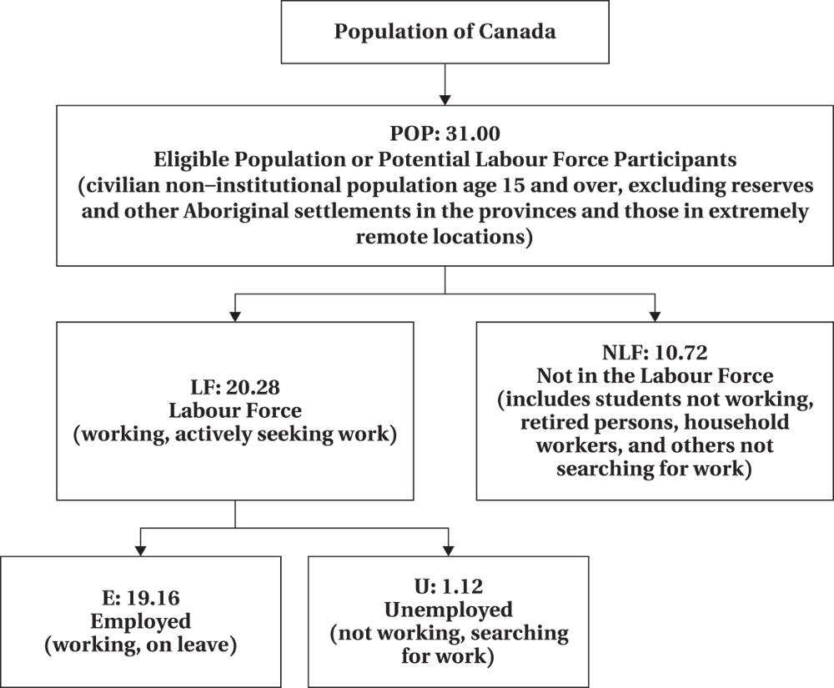
The Theory of Labour Supply
Figure 2.1 Labour Force Concepts (numbers as of January 2020)
© 2021 MCGRAW-HILL EDUCATION LTD.
2-<number>

Slide 7
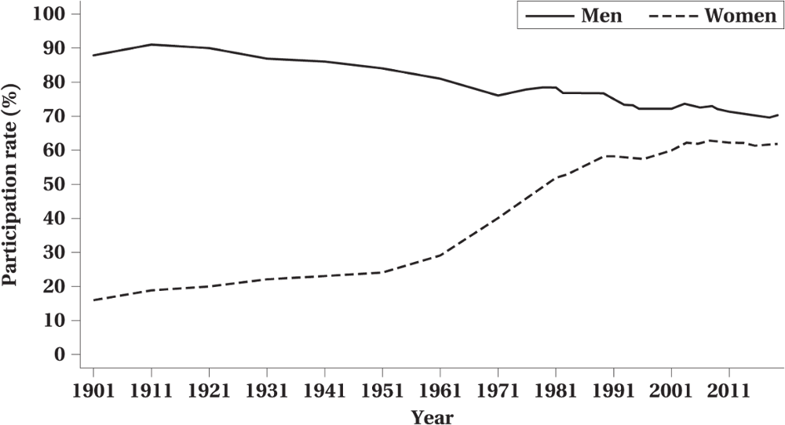
The Theory of Labour Supply
Figure 2.2 Labour Force Participation Rates by Sex, Canada, 1901–2019
© 2021 MCGRAW-HILL EDUCATION LTD.
2-<number>

Slide 8
The Theory of Labour Supply
TABLE 2.1 Labour Force Participation Rates by Sex, Selected Countries, 2018
Country | Abbreviation | Overall | Male | Female | Difference
Sweden | SWE | 82.9 | 84.8 | 81.0 | 3.7
Vietnam | VNM | 82.7 | 86.4 | 79.1 | 7.3
Peru | PER | 80.3 | 887.2 | 73.3 | 13.9
Canada | CAN | 78.5 | 81.9 | 75.1 | 6.8
United Kingdom | GBR | 77.5 | 82.2 | 72.8 | 9.4
Norway | NOR | 77.3 | 79.2 | 75.2 | 4.0
Russia | RUS | 74.1 | 79.8 | 68.9 | 10.9
Jamaica | JAM | 72.4 | 78.0 | 66.9 | 11.1
United States | USA | 72.3 | 77.7 | 66.8 | 10.9
France | FRA | 71.7 | 75.8 | 67.5 | 8.2
Kenya | KEN | 66.9 | 69.6 | 64.1 | 5.5
Italy | ITA | 65.3 | 74.9 | 55.7 | 19.2
Mexico | MEX | 64.7 | 82.6 | 47.1 | 35.5
Philippines | PHL | 62.0 | 76.2 | 47.7 | 35.5
Bangladesh | BGD | 61.1 | 83.9 | 38.1 | 45.8
South Africa | ZAF | 59.6 | 66.0 | 53.4 | 12.5
Nigeria | NGA | 55.2 | 59.9 | 50.5 | 9.4
Egypt | EGY | 51.1 | 76.9 | 24.7 | 52.2
Jordan | JOR | 41.6 | 67.4 | 15.1 | 52.3
© 2021 MCGRAW-HILL EDUCATION LTD.
2-<number>

Slide 9
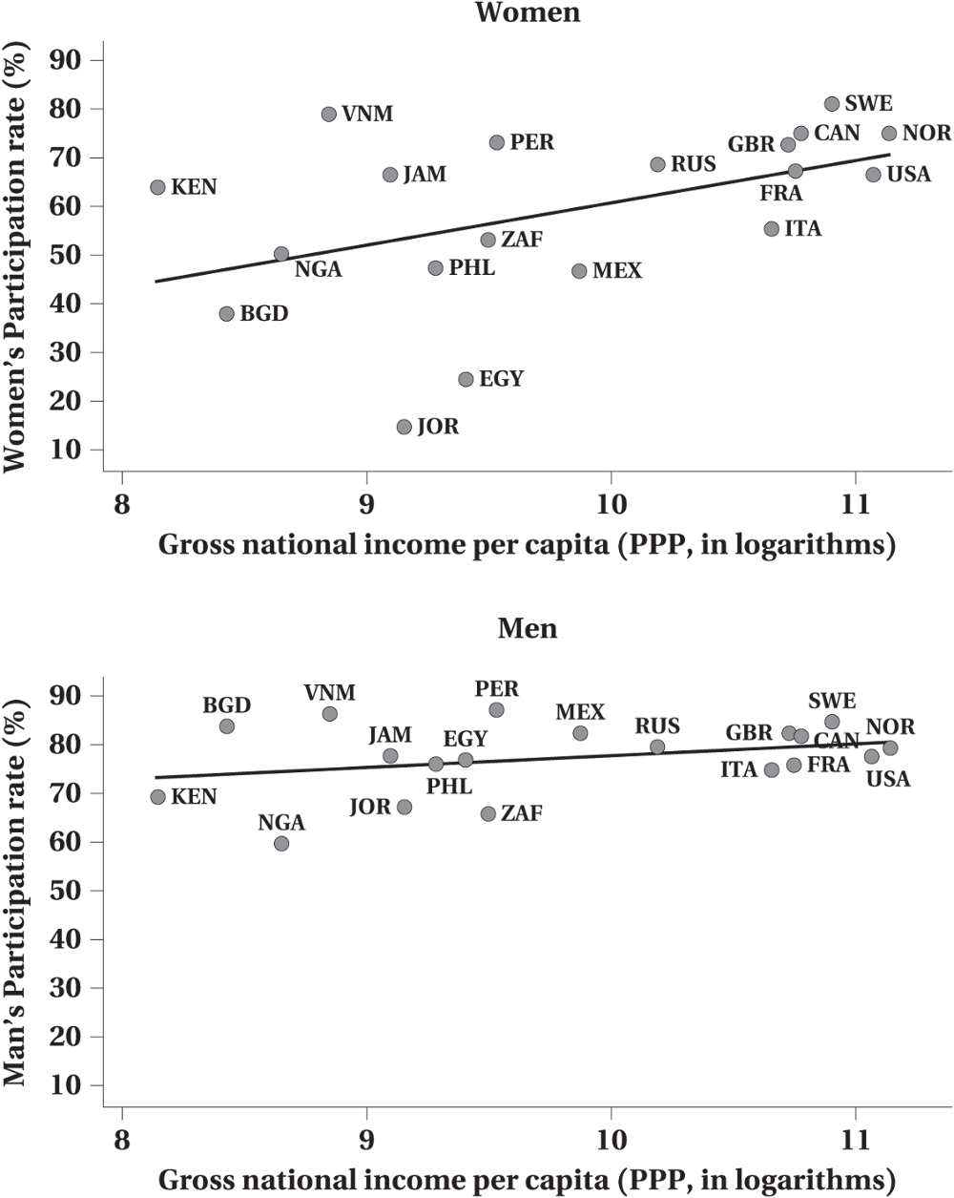
The Theory of Labour Supply
Figure 2.3 Male and Female Participation Rates by Level of Economic Development
© 2021 MCGRAW-HILL EDUCATION LTD.
2-<number>

Slide 10
The Theory of Labour Supply
Hours-of-work
  Hours per day, days per week, weeks per year
  It may affect the quantity and the quality of labour supply
© 2021 MCGRAW-HILL EDUCATION LTD.
2-<number>

Slide 11
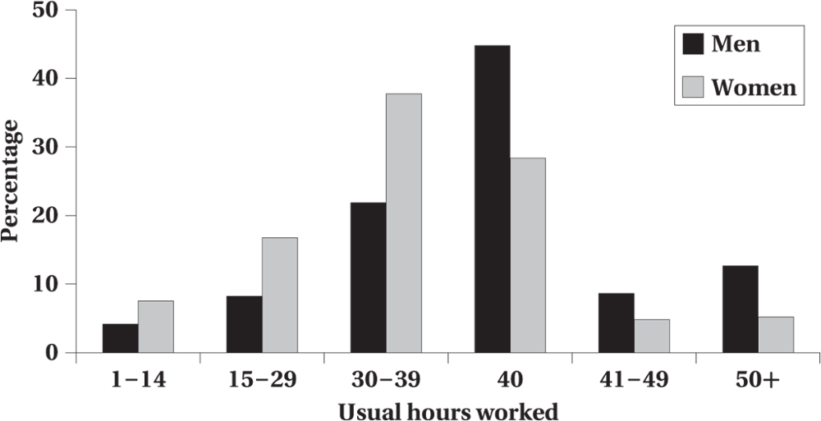
The Theory of Labour Supply
Figure 2.4 Distribution of Hours Worked Per Week by Sex, 2019
© 2021 MCGRAW-HILL EDUCATION LTD.
2-<number>

Slide 12
The Theory of Labour Supply
Basic Income-Leisure Model
The choice of hours worked given opportunities and value of non-market time
  Preferences and Constraints
  Individuals choose the feasible outcomes which yield the highest level of satisfaction
© 2021 MCGRAW-HILL EDUCATION LTD.
2-<number>

Slide 13
The Theory of Labour Supply
Preferences
Two “goods”
  Consumption
  Leisure
Represented by indifference curves
(A person is indifferent between various combinations of consumption and leisure on an indifference curve)
© 2021 MCGRAW-HILL EDUCATION LTD.
2-<number>

Slide 14
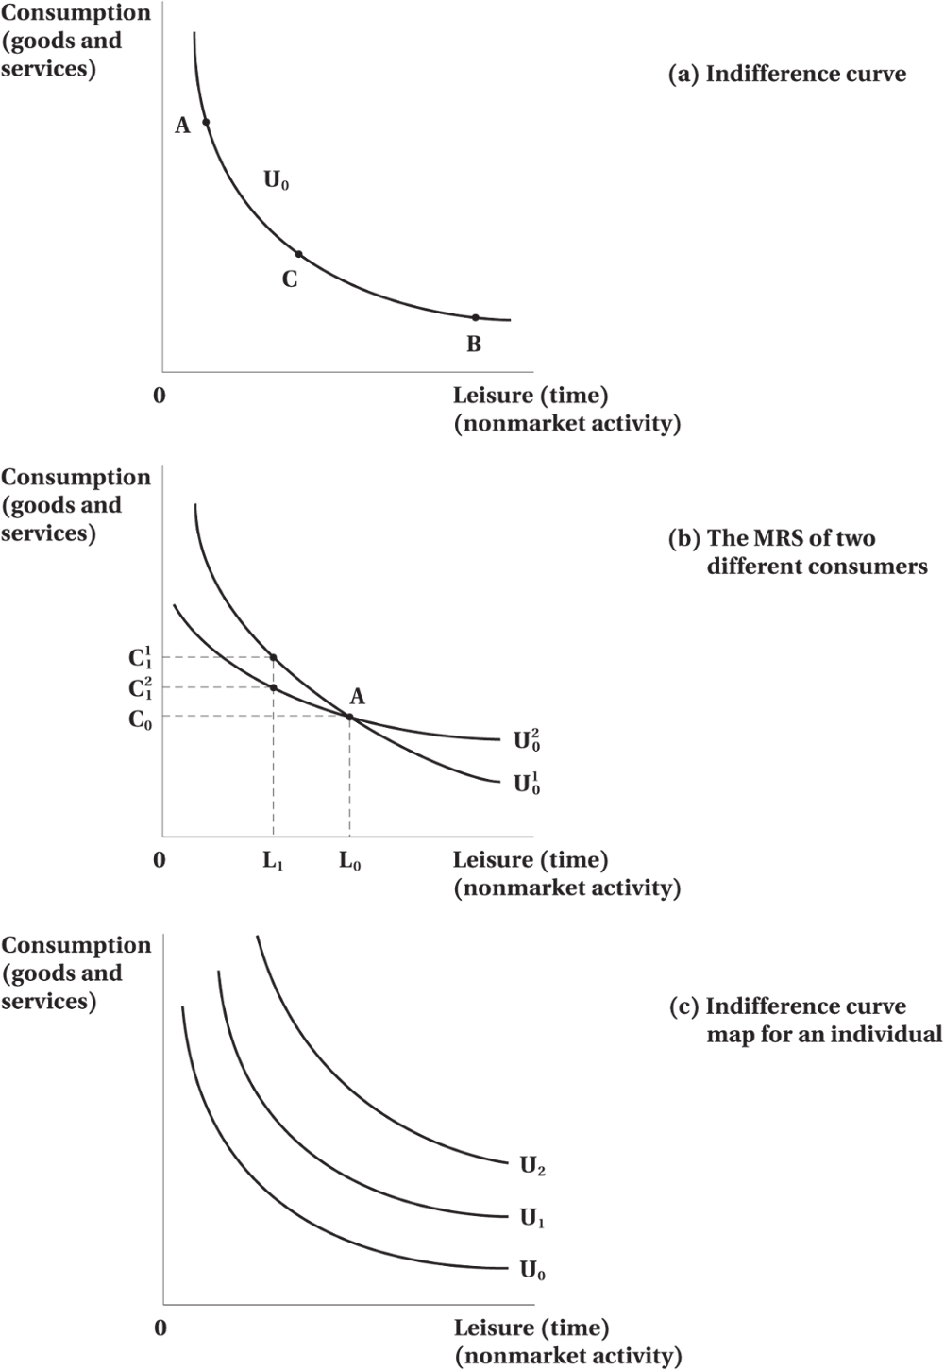
The Theory of Labour Supply
Figure 2.5 Consumer Preferences: Consumption-Leisure Indifference Curves
© 2021 MCGRAW-HILL EDUCATION LTD.

Slide 15
The Theory of Labour Supply
Preferences
We assume that consumers have well-defined preferences over all the conceivable combinations of consumption and leisure.
This implies that all combinations lie on some indifference curve.
Consumer preferences can then be represented by an indifference curve.
Indifference curves plot combinations of consumption and leisure that yield the consumer equal levels of utility.
The absolute value of the slope of an indifference curve gives the marginal rate of substitution (MRS); that is, the amount of leisure the consumer is willing to accept in exchange for giving up some consumption.
© 2021 MCGRAW-HILL EDUCATION LTD.
2-<number>

Slide 16
The Theory of Labour Supply
Constrained
Constrained are determined by the economic properties of the market, which, in turn, transform consumption-leisure to income-leisure by setting the price of consumption.
The income and leisure combinations from which the consumer can choose with a potential income constraint.
This allows a transformation of our model from representing consumption-leisure tradeoffs to income-leisure tradeoffs.
Alternative phrases used for the potential income constraint include budget constraint, income constraint, and full-income constraint.
© 2021 MCGRAW-HILL EDUCATION LTD.
2-<number>

Slide 17
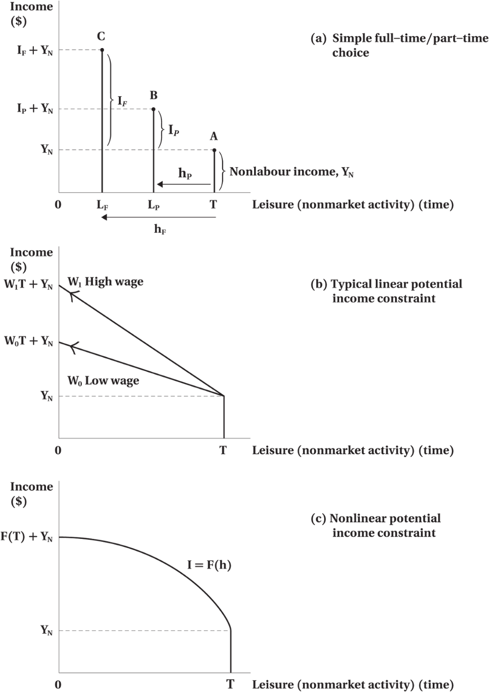
The Theory of Labour Supply
Figure 2.6 Potential Income Constraints: Summarizing Individual Market Opportunities
© 2021 MCGRAW-HILL EDUCATION LTD.
2-<number>

Slide 18
The Theory of Labour Supply
The Consumer’s Optimum
Optimal amount of income and leisure
Utility-maximizing equilibrium
  Highest indifference curve given the income constraint
Compare MRS with the Market Wage Rate
  MRS: measures the willingness to exchange leisure for consumption (or income)
  Market Wage Rate: measures the ability to exchange leisure for income
© 2021 MCGRAW-HILL EDUCATION LTD.
2-<number>

Slide 19
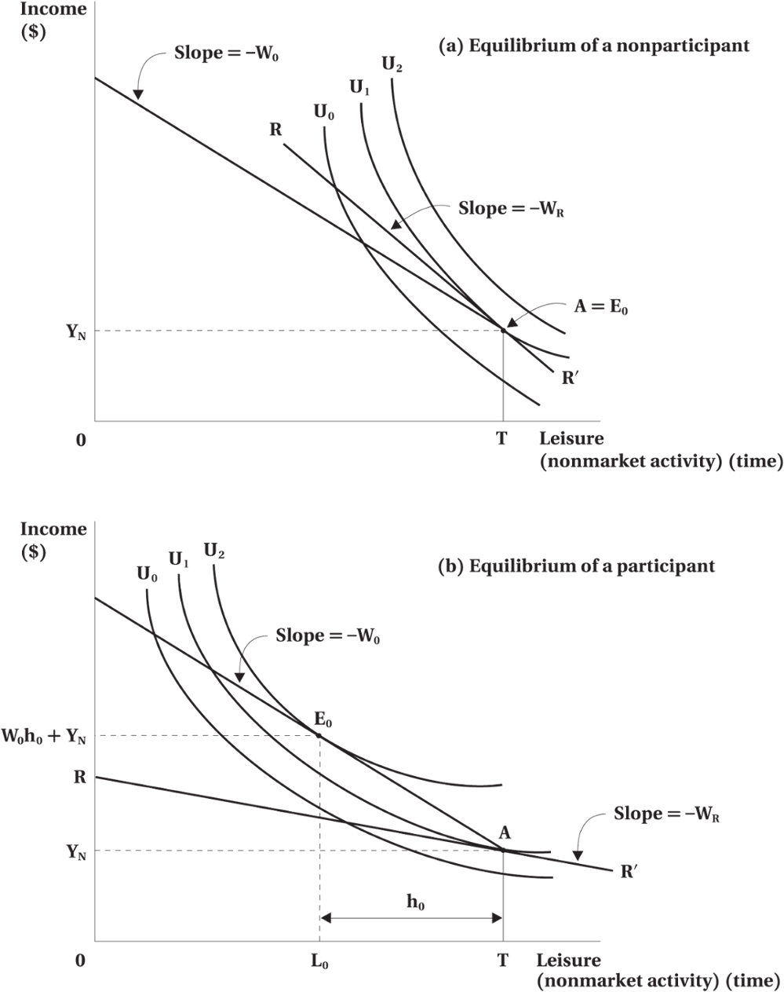
The Theory of Labour Supply
Figure 2.7 The Consumer’s Labour Supply Decision
© 2021 MCGRAW-HILL EDUCATION LTD.

Slide 20
The Theory of Labour Supply
Worked Example: Working Part-Time at University
Jack and Jill both attend the same university and are deciding whether to work part-time while they are in school.
Both have identical financial situations: their parents give them a weekly allowance of $100, and they can work as much as they would like at the local Mega-Mart, at a wage of $10 per hour.
Over a given week, they each have sleep and personal maintenance requirements of 10 hours per day, leaving a total of 7 × 14 = 98 hours available for discretionary activities.
Out of this 98 hours, they have to decide how much time to spend working at the Mega-Mart versus time with their studies, partying, socializing with friends, or watching TV.
© 2021 MCGRAW-HILL EDUCATION LTD.
2-<number>

Slide 21
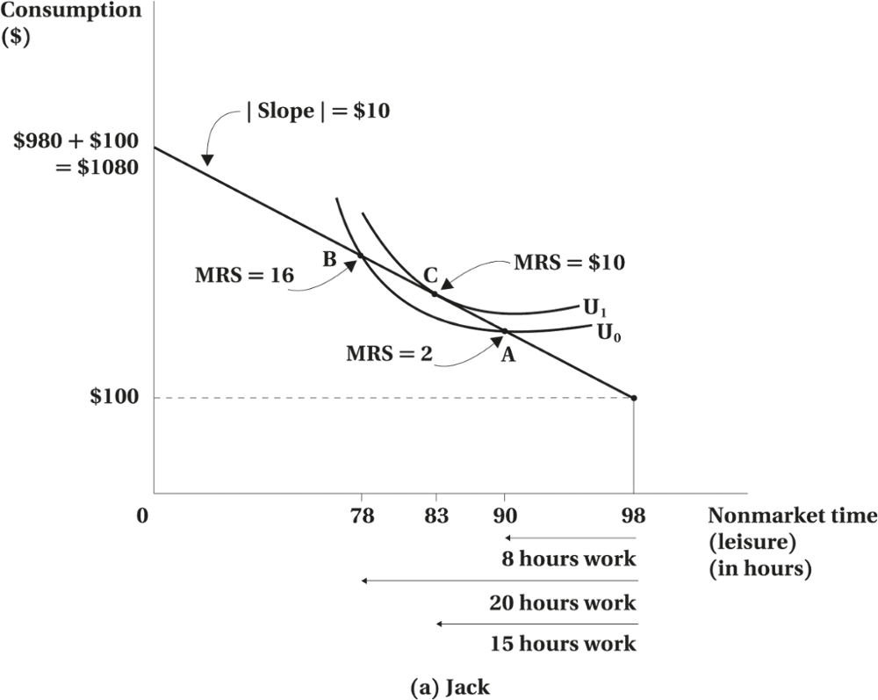
The Theory of Labour Supply
© 2021 MCGRAW-HILL EDUCATION LTD.
2-<number>

Slide 22
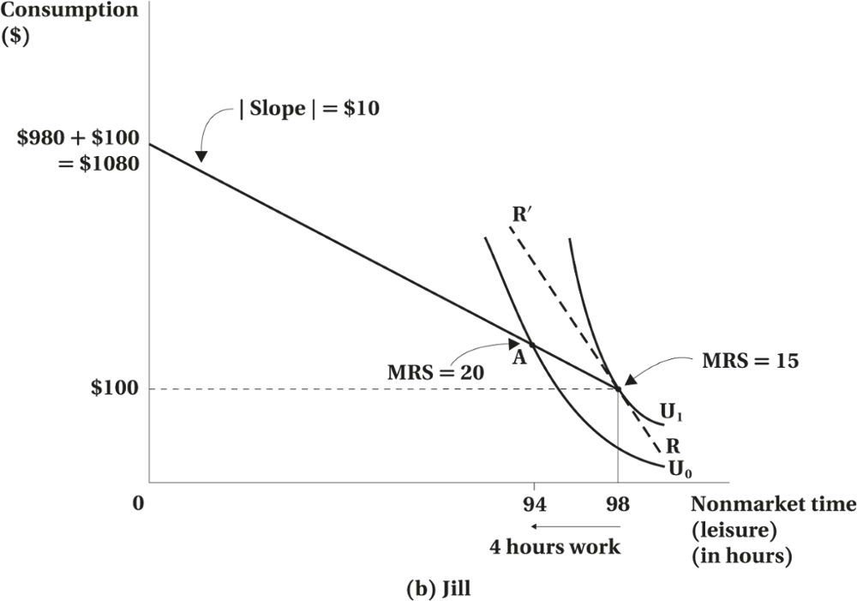
The Theory of Labour Supply
© 2021 MCGRAW-HILL EDUCATION LTD.
2-<number>

Slide 23
The Theory of Labour Supply
Comparative Statics
Hours of Work For Participate
Increase in non-labour income results in a parallel outward shift of the budget constraint
  Leisure, Normal good:
  More leisure will be consumed resulting in less work hours
  Leisure, Inferior good:
  Less leisure will be consumed resulting in more work hours
© 2021 MCGRAW-HILL EDUCATION LTD.
2-<number>

Slide 24
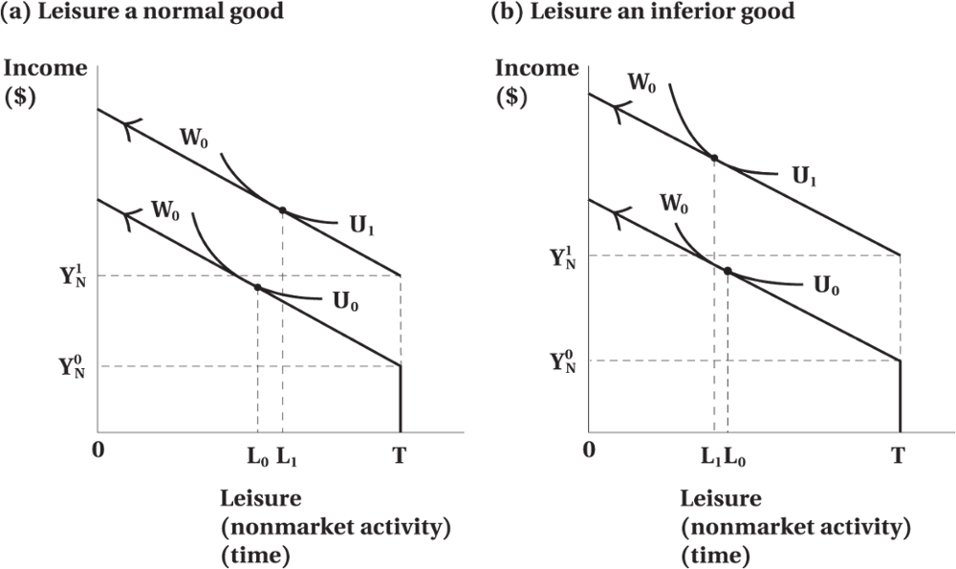
The Theory of Labour Supply
Figure 2.8 The Effect of an Increase in Nonlabour Income on Labour Supply
© 2021 MCGRAW-HILL EDUCATION LTD.
2-<number>

Slide 25
The Theory of Labour Supply
Change in Wage Rate on Hours of Work
Two effects:
Income effect The worker has more income to buy more goods including leisure (reduces work hours)
Substitution effect Individual may work more because the returns are greater substituting away from leisure
© 2021 MCGRAW-HILL EDUCATION LTD.
2-<number>

Slide 26
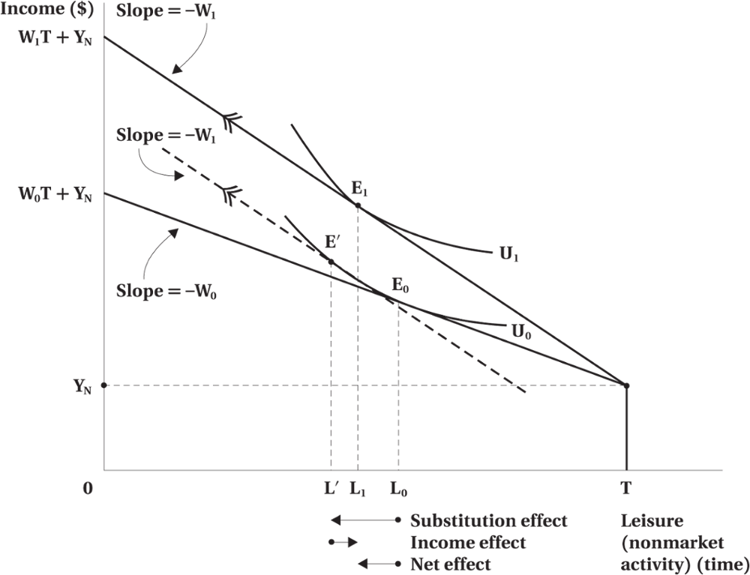
The Theory of Labour Supply
Figure 2.9 Income and Substitution Effects of a Wage Increase
© 2021 MCGRAW-HILL EDUCATION LTD.
2-<number>

Slide 27
The Theory of Labour Supply
Effect of Wage Increase on Participation
The net effect depends on both substitution effect and income effect.
If income effect dominates, hours of work may decline.
For a non-participant an increase in wages may leave the equilibrium unchanged or induce the individual to participate.
© 2021 MCGRAW-HILL EDUCATION LTD.
2-<number>

Slide 28
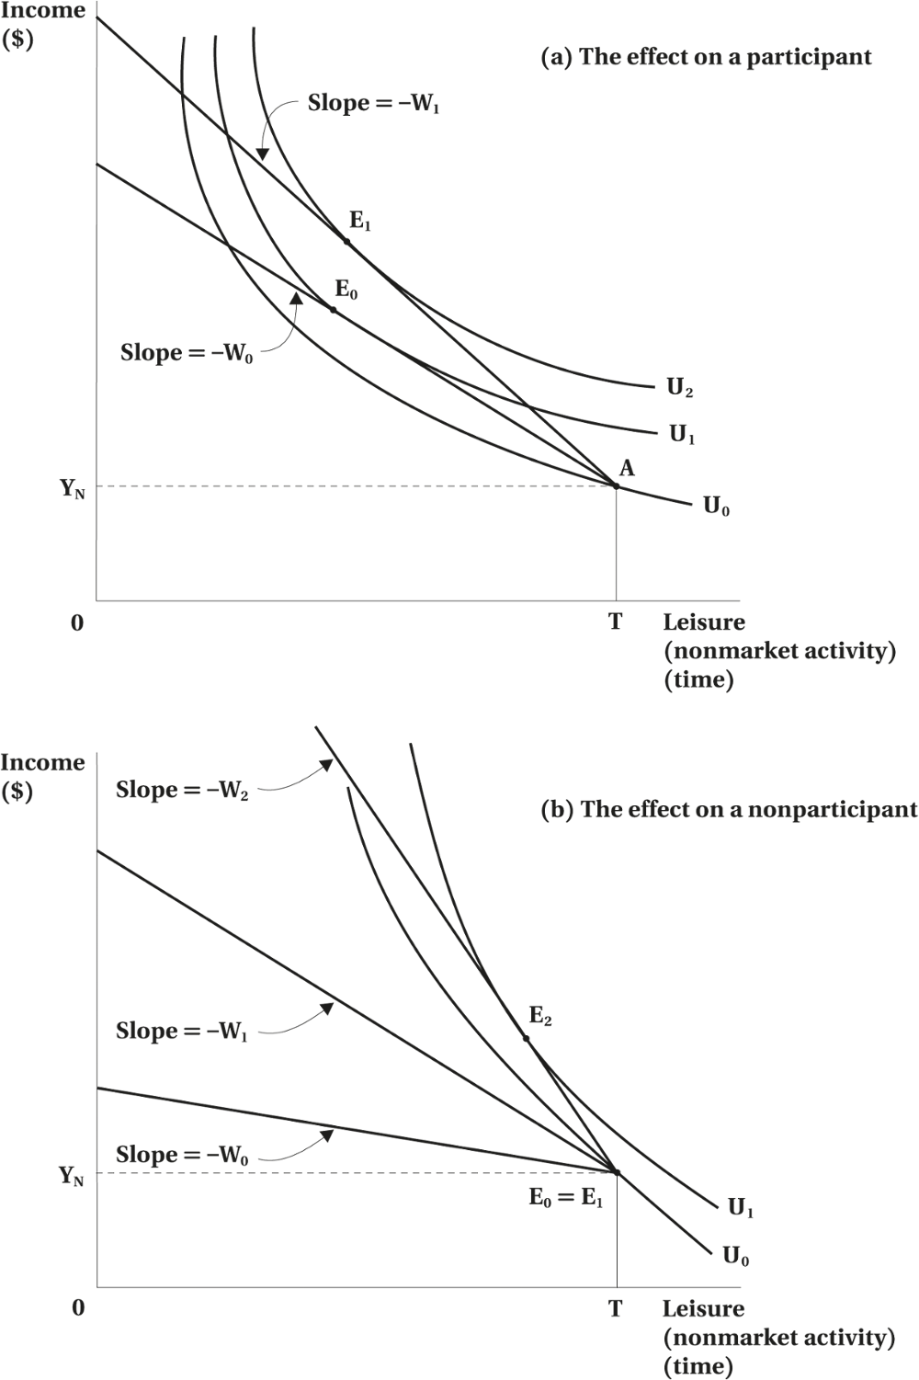
The Theory of Labour Supply
Figure 2.10 The Effect of a Wage Increase on Participation
© 2021 MCGRAW-HILL EDUCATION LTD.
2-<number>

Slide 29
The Theory of Labour Supply
Deriving the Individual Supply Curve of Labour
If substitution effect dominates,
  Increase in wages leads to increase in labour supplied
  Wages continue to increase until a point where substitution effect and income effect offset each other
Supply curve bends backward when income effect dominates substitution effect
© 2021 MCGRAW-HILL EDUCATION LTD.
2-<number>

Slide 30
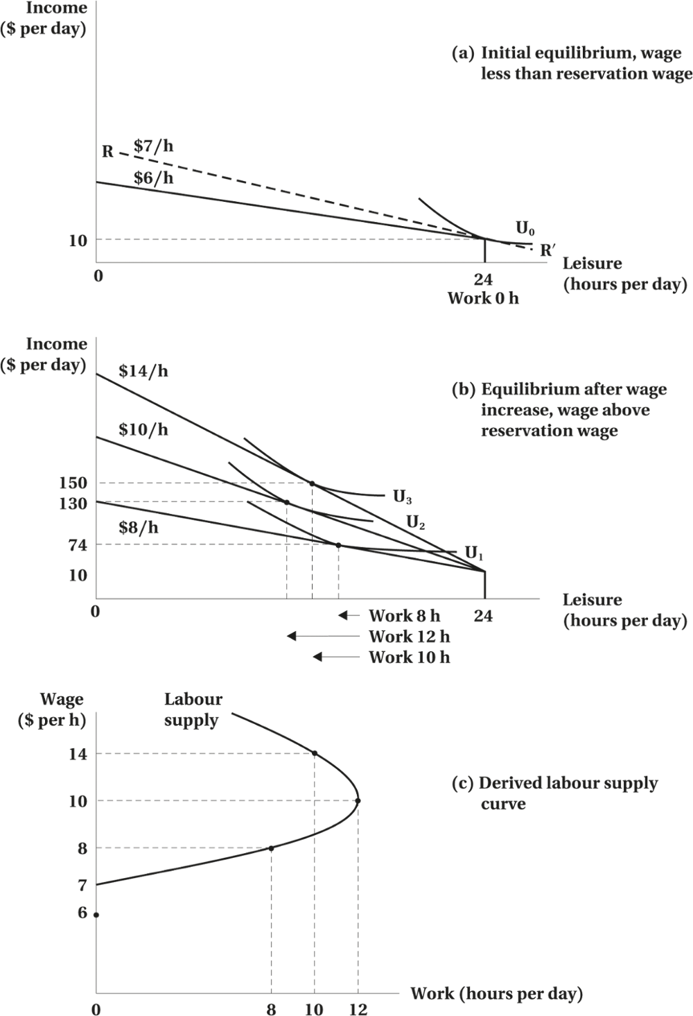
The Theory of Labour Supply
Figure 2.11 Deriving the Individual Supply Curve of Labour
© 2021 MCGRAW-HILL EDUCATION LTD.
2-<number>

Slide 31
The Theory of Labour Supply
Empirical Evidence
Testing the Model of Labour Supply
Two Research Questions
  Does labour supply behaviour conform to the predictions of economic theory?
  How responsive is labour supply to changes in the wage?
© 2021 MCGRAW-HILL EDUCATION LTD.
2-<number>

Slide 32
TABLE 2.2 Labour Force Participation Rates of Married Women, Canada 2017
 | Percentage of Married Women | Participation Rateª | Raw Difference from Base Group^{b} | Adjusted Difference from Base Group^{c}
All Women, Total |  | 75.3
Age
20–24 | 1.1 | 89.4 | N/A | N/A
25–34 | 18.9 | 84.4 | –5.0 | –3.7
35–44 | 23.9 | 85.5 | –3.9 | –3.0
45–54 | 24.0 | 84.8 | –4.6 | –7.3
55–64 | 23.8 | 64.8 | –24.6 | –22.3
65–69 | 8.4 | 27.5 | –61.9 | –52.6
Age of youngest child, under 18 years old, at home
No children under 18 | 60.1 | 70.9 | N/A | N/A
0–5 years old | 18.4 | 77.4 | 6.5 | –13.9
6–9 years old | 7.7 | 84.6 | 13.7 | –5.4
10–15 years old | 10.1 | 87.0 | 16.1 | –0.7
16–17 years old | 3.7 | 86.3 | 15.4 | 0.2
Education
Less than high school graduation | 8.2 | 49.6 | N/A | N/A
High school graduate or some post-secondary | 23.6 | 67.9 | 18.3 | 12.1
Non-university, post-secondary certificate | 30.7 | 77.8 | 28.2 | 18.8
University degree | 37.6 | 83.7 | 34.1 | 22.4
Spouse's income
None (or negative) | 18.0 | 49.7 | N/A | N/A
$1–$9,999 | 8.7 | 62.0 | 12.3 | 7.7
$10,000–$24,999 | 9.1 | 78.6 | 28.9 | 17.5
$25,000–$49,999 | 18.2 | 82.3 | 32.6 | 18.4
$50,000–$74,999 | 17.1 | 87.1 | 37.4 | 21.0
$75,000–$99,999 | 12.4 | 86.3 | 36.6 | 18.9
$100,000–$149,999 | 10.7 | 84.2 | 34.5 | 17.1
Over $150,000 | 5.7 | 74.1 | 24.4 | 7.4
© 2021 MCGRAW-HILL EDUCATION LTD.
2-<number>

Slide 33
The Theory of Labour Supply
Empirical Evidence
Evidence of the Elasticity of Labour Supply
  Uncompensated elasticity
  Compensated elasticity
  Income elasticity
© 2021 MCGRAW-HILL EDUCATION LTD.
2-<number>

Slide 34
The Theory of Labour Supply
TABLE 2.3 Estimated Elasticities of Labour Supply
Sex | Uncompensated (Gross, Total) Wage Elasticity of Supply | Compensated (Substitution) Wage Elasticity of Supply | Income Elasticity of Supply
Both sexes | 0.0 to 0.2 | 0.1 to 0.3 | –0.1 to 0.0
Men and single women | –0.1 to 0.2 | 0.1 to 0.3 | –0.1 to 0.0
Married women | 0.1 to 0.3 | 0.2 to 0.4 | –0.1 to 0.0
© 2021 MCGRAW-HILL EDUCATION LTD.
2-<number>

Slide 35
Extensions and Applications
Discouraged worker effects
  In periods of high unemployment, people may become discouraged from looking for work and drop out of the labour force
Added worker effects
  In periods of high unemployment, some may enter the labour force to supplement family income that may have deteriorated with the unemployment of other family members.
© 2021 MCGRAW-HILL EDUCATION LTD.
2-<number>

Slide 36
Extensions and Applications
Hidden Unemployment
The discouraged worker effect and the problem of hidden unemployment
“Secondary” or “marginal” workers
© 2021 MCGRAW-HILL EDUCATION LTD.
2-<number>

Slide 37
Extensions and Applications
Moonlighting, Overtime, Flexible Work Hours
Why do some people moonlight at a second job at a wage less than their market wage on their first job?
Why do some people require an overtime premium to work more?
© 2021 MCGRAW-HILL EDUCATION LTD.
2-<number>

Slide 38
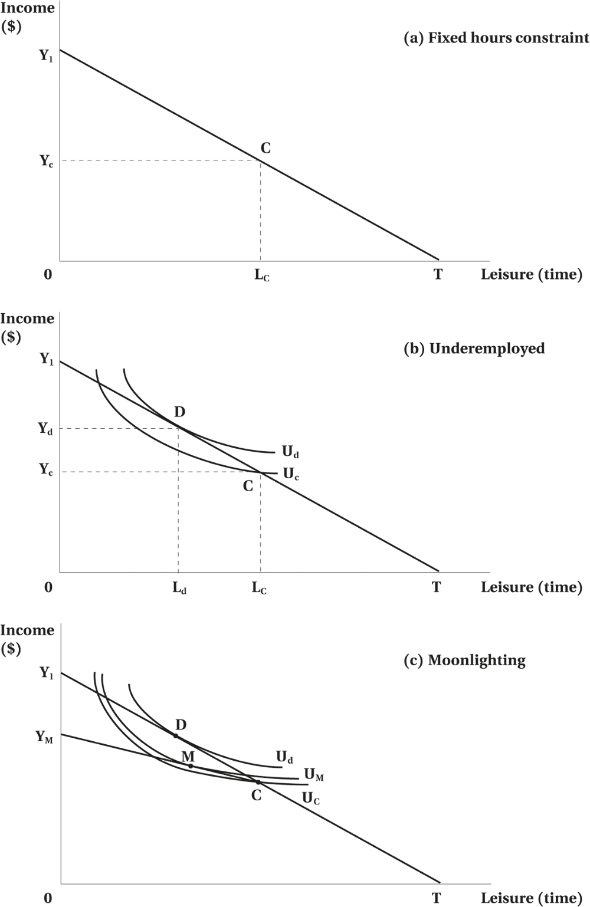
Extensions and Applications
Figure 2.12 Fixed Hours Constraint, Underemployment, and Moonlighting
© 2021 MCGRAW-HILL EDUCATION LTD.
2-<number>

Slide 39
Extensions and Applications
Overtime and Overemployment
Workers prefer to work fewer hours at the going wage rate
Workers are induced to work more hours through an overtime premium
© 2021 MCGRAW-HILL EDUCATION LTD.
2-<number>

Slide 40
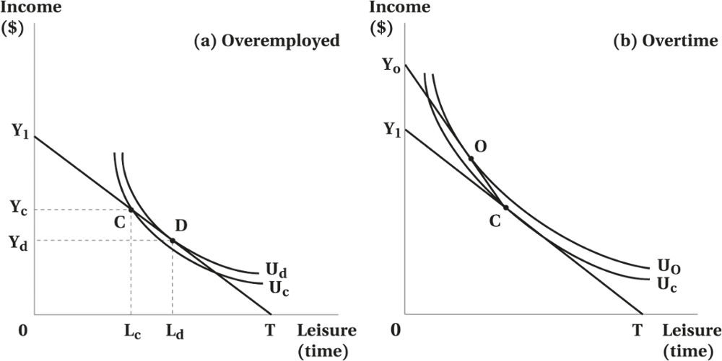
Extensions and Applications
Figure 2.13 Overemployment and Overtime
© 2021 MCGRAW-HILL EDUCATION LTD.
2-<number>

Slide 41
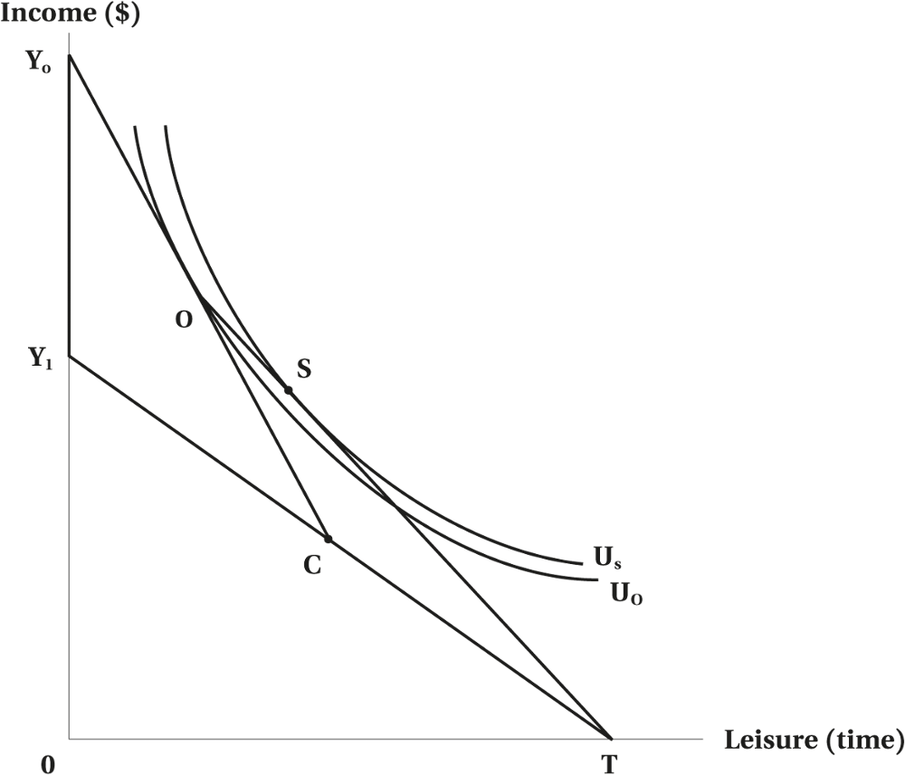
Extensions and Applications
Figure 2.14 Overtime Premium versus Straight-Time Equivalent
© 2021 MCGRAW-HILL EDUCATION LTD.
2-<number>

Slide 42
Extensions and Applications
Choice in Working Hours
Different groups with different preferences for work-time arrangements
Allowing workers to work desired number of hours saves on costs
Flex-time and compressed work week
© 2021 MCGRAW-HILL EDUCATION LTD.
2-<number>

Slide 43
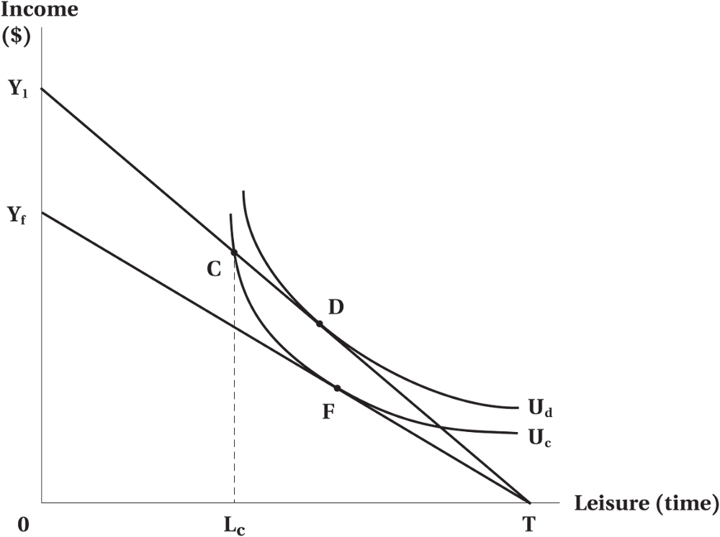
Extensions and Applications
Figure 2.15 Gains from Alternative Work Schedules
© 2021 MCGRAW-HILL EDUCATION LTD.
2-<number>

Slide 44
Chapter Summary
Individual attachment to the labour market is measured in two ways: first, whether an individual is working or searching for work (the participation dimension); and second, how many hours they work (the hours dimension).
The microeconomic model of consumer choice can accommodate both dimensions of the labour supply decision. Individuals choose their preferred combination of income (consumption) and leisure (nonmarket time), as represented by their opportunity set, or potential income constraint.
The reservation wage is the critical wage to the participation decision: for wage rates above the reservation wage, the consumer will choose to work; for wages below, the consumer will not participate.
© 2021 MCGRAW-HILL EDUCATION LTD.
2-<number>

Slide 45
Chapter Summary
The labour supply model can be used to build an individual’s labour supply curve. By varying the wage rate, we can trace out the individual's optimal choice of hours worked, holding all other factors constant.
The labour supply model can be used to investigate a variety of labour market phenomena, such as the “added worker effect,” the structure of overtime wage premiums, and the willingness of individuals to accept flexibility in work hours in exchange for lower wages.
© 2021 MCGRAW-HILL EDUCATION LTD.
2-<number>

